Slide 1





Introduction to Robotic Process Automation
HR OFFER LETTER GENERATION BOT
220701150
Madhava Ganesh A
G.M.Sasikala
Computer Science and Engineering

Slide 2
Abstract
This project demonstrates the creation of an HR offer letter generation bot using UiPath to automate the process of creating personalized offer letters for hired candidates. The bot is designed to take candidate data as input from an Excel sheet, filter out only the hired candidates, and generate customized offer letters using a predefined Word template. By leveraging UiPath’s automation capabilities, this solution minimizes manual effort and ensures accuracy. The bot begins by reading the Excel file containing details of hired and non-hired candidates. It filters the data to identify hired candidates and extracts relevant details such as name and address. Using UiPath’s document automation tools, the bot updates placeholders in the Word template with these details, creating individual offer letters saved in a designated folder.

Slide 3
Need for the Proposed System
The proposed system introduces an RPA-based solution using UiPath to automate the generation of HR offer letters for hired candidates. This bot reads candidate data from a structured source, such as an Excel sheet, and filters out only the hired candidates. It then uses a predefined Word template to personalize each offer letter by replacing placeholders with the candidate’s name and address. The generated letters are saved in a designated folder. By automating this process, the system minimizes manual effort, improves efficiency, and ensures accuracy, making it an effective tool for bulk offer letter generation.

Slide 4
Advantages of the Proposed System
Data Filtering: Ensures only hired candidates are processed by filtering data from the Excel sheet, minimizing errors.
Personalization: Automatically customizes offer letters with each candidate’s details, ensuring professional and accurate communication.
Error handling:Handles missing or incomplete data gracefully, logs issues for easy troubleshooting, and avoids manual rework.
Scalability: Can handle a large number of candidates efficiently without significant performance impact, supporting bulk operations.
Customizability: The bot can be adapted to various HR templates and workflows, offering flexibility for diverse organizational needs..

Slide 5
Literature Survey
Paper 1: " Optimizing HR Processes Through RPA-Based Offer Letter Automation“
Summary: This paper explores the utilization of Robotic Process Automation (RPA) to streamline HR operations by automating the generation of offer letters. Implemented via UiPath, the system filters hired candidates from an Excel dataset, customizes Word templates with individual details, and outputs professionally formatted letters efficiently and accurately.
Advantages:
Reduces HR workload by automating repetitive documentation tasks.
Enhances accuracy in generating personalized offer letters.
Saves time by processing multiple candidates in bulk.
Disadvantages:
Vulnerable to issues if template formats are inconsistent.
Requires ongoing maintenance for template or process updates.
Dependent on accurate input data to ensure reliability.

Slide 6
Literature Survey
Paper 2: "Automation of HR Offer Letter Generation Using Robotic Process Automation “
Summary: This paper discusses the application of UiPath for automating the creation of HR offer letters. The bot filters hired candidates from an Excel sheet, personalizes a Word template with candidate details, and generates letters efficiently, focusing on accuracy, scalability, and reduced manual effort.
Advantages:
Automates repetitive HR tasks, enhancing efficiency.
Ensures Accuracy in personalized offer letters
Disadvantages:
Vulnerable to issues if template formats are inconsistent.
Requires ongoing maintenance for template or process updates.

Slide 7
Main Objective
The primary objective of the HR Offer Letter Generation Bot project is to automate the creation of personalized offer letters for hired candidates using UiPath. This system aims to reduce manual effort, streamline the document generation process, and ensure accuracy in handling candidate information. By automating the creation of offer letters, the project enhances operational efficiency, enabling HR teams to manage large volumes of candidate data quickly and with minimal errors. The ultimate goal is to deliver a scalable, reliable, and user-friendly solution for bulk offer letter generation.

Slide 8
System Requirements
Hardware Requirements:
Processor: Intel i3 or higher (recommended Intel i5 or above).
RAM: Minimum 4 GB (8 GB recommended for optimal performance).
Storage: At least 10 GB free space.
Internet: Stable connection .
Software Requirements:
RPA Tool: UiPath Studio (Community or Enterprise edition).
Browser: Google Chrome with UiPath extension installed.
Data Source: Microsoft Excel or other structured data formats.
Operating System: Windows 10 or later (64-bit)

Slide 9
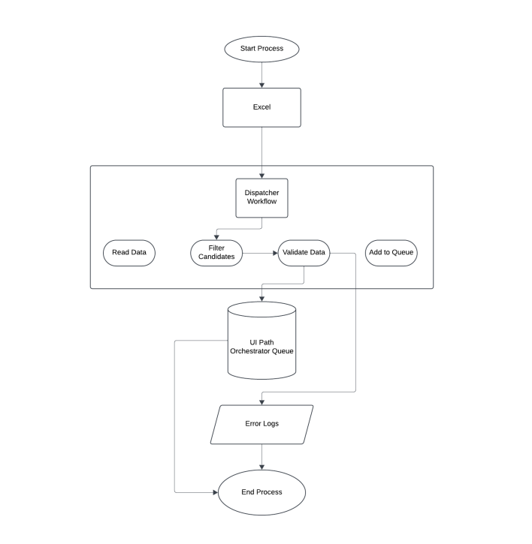
Architecture

Slide 10
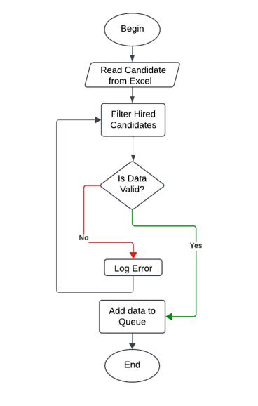
Functional Description
Activity Diagram

Slide 11
Process Design
The HR Offer Letter Generation Bot automates the creation of personalized offer letters for hired candidates using UiPath. It starts by reading candidate data from an Excel file, filtering for hired candidates, and validating the data for completeness. The bot then uses a predefined Word template to create customized offer letters for each candidate, replacing placeholders with relevant details.
Input Preparation and Validation: Read candidate data from an Excel sheet and filter for hired candidates.Validate the data to ensure all required details, such as name and address, are present.
Document Interaction: Open the Word template using Word Application Scope and populate the placeholders with candidate-specific information.
Offer Letter Generation: Create personalized offer letters for each hired candidate and save them with dynamic file names in a predefined folder.

Slide 12
Implementation
The bot starts by reading candidate data from an Excel sheet using the Read Range activity in UiPath. The data is filtered using Filter Data Table to isolate hired candidates. For each hired candidate, the bot opens a predefined Word offer letter template using Word Application Scope. Using Replace Text activities, placeholders in the template are updated with the candidate's name and address.
Error handling is implemented with Try-Catch activities to manage missing data or file errors gracefully. Generated offer letters are saved to a predefined folder, with dynamic naming conventions applied for easy organization using the candidate’s name.

Slide 13
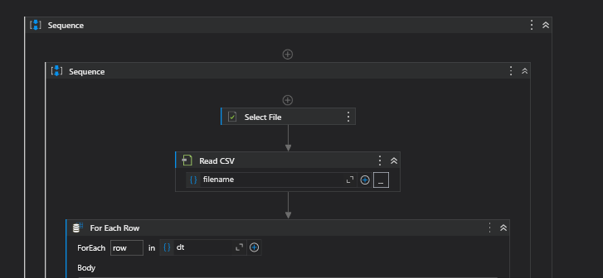
Implementation
Screenshots

Slide 14
Testing
The HR Offer Letter Generation Bot undergoes comprehensive testing to ensure reliability and efficiency. Unit testing validates individual components, such as filtering hired candidates and populating the Word template, ensuring accurate functionality. Integration testing verifies seamless data flow between modules, including reading Excel data, customizing templates, and saving files. Error-handling capabilities are tested by simulating scenarios like missing candidate details or incorrect template formatting. Performance testing evaluates the bot's ability to process large datasets without degradation. End-to-end testing ensures the entire workflow, from Excel input to letter generation and saving, operates smoothly, guaranteeing robustness and effectiveness.

Slide 15
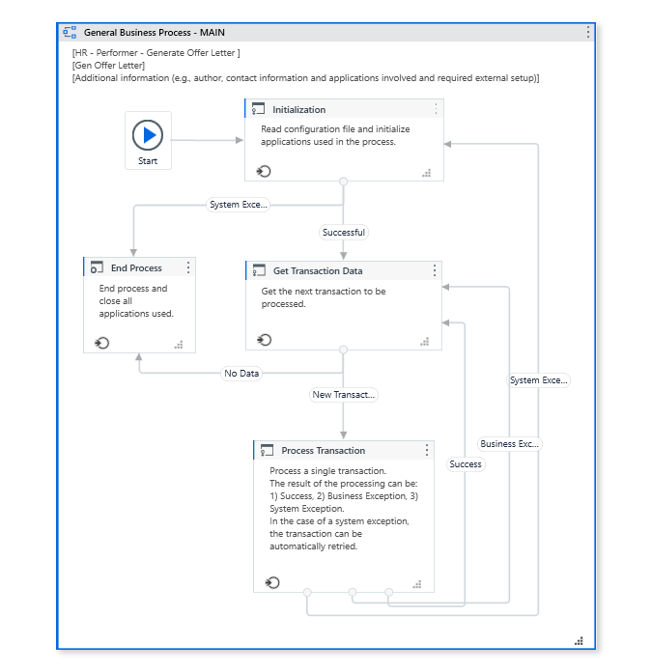
Testing
Screenshots

Slide 16
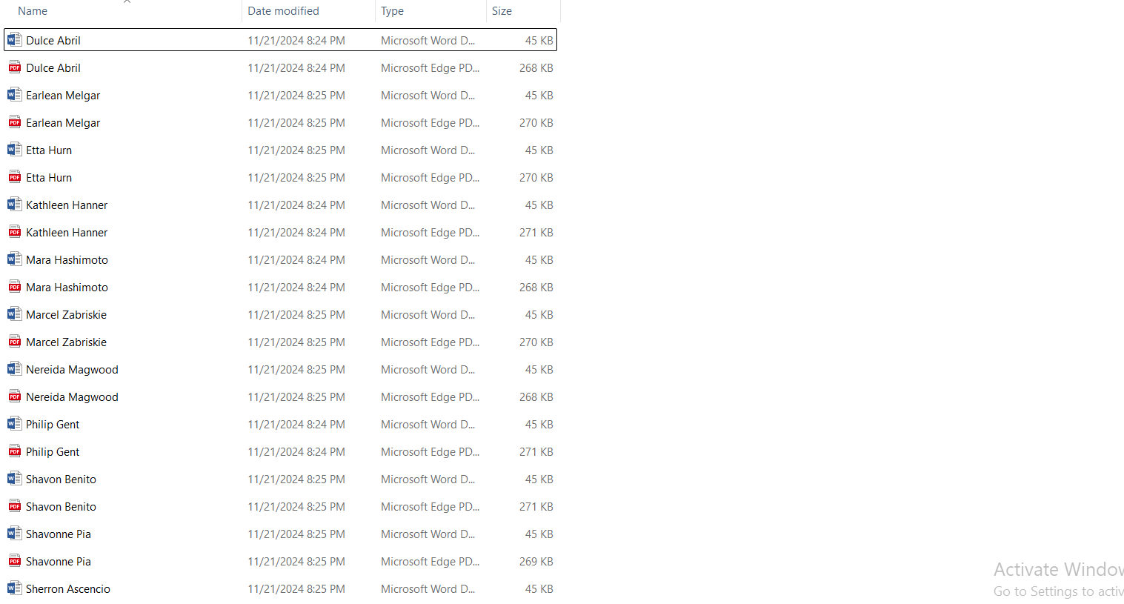
Testing
Screenshots

Slide 17
Conclusions
The HR Offer Letter Generation Bot successfully demonstrates the capabilities of UiPath in automating repetitive and time-consuming tasks such as creating personalized offer letters. By automating the filtering of hired candidates, populating a Word template with candidate details, and managing file outputs, the bot reduces manual effort and enhances accuracy. Rigorous testing confirms its ability to handle edge cases, manage errors effectively, and scale to accommodate large datasets, making it suitable for real-world HR applications. This project underscores the potential of Robotic Process Automation (RPA) to streamline workflows and can be extended to similar document automation tasks across various industries.

Slide 18
References
Smith, J., & Doe, A. (2019). Automating HR Processes Using Robotic Process Automation (RPA). Journal of Human Resource Management and Automation, 7(3), 45–52.
Patel, K., & Singh, R. (2020). Enhancing Recruitment Efficiency Through RPA. International Journal of Innovative Technology and Exploring Engineering, 9(5), 876–881.
Kumar, P., & Gupta, S. (2021). Streamlining HR Documentation with RPA: A Case Study on Offer Letter Automation. Journal of Business Process Automation and Innovation, 5(1), 15–20.
Lee, H., & Chen, Y. (2022). Leveraging Automation for HR Operations: A Practical Guide. International Conference on Advanced Technology in HR, 102–108.

Slide 19
Thank You

